Slide 1
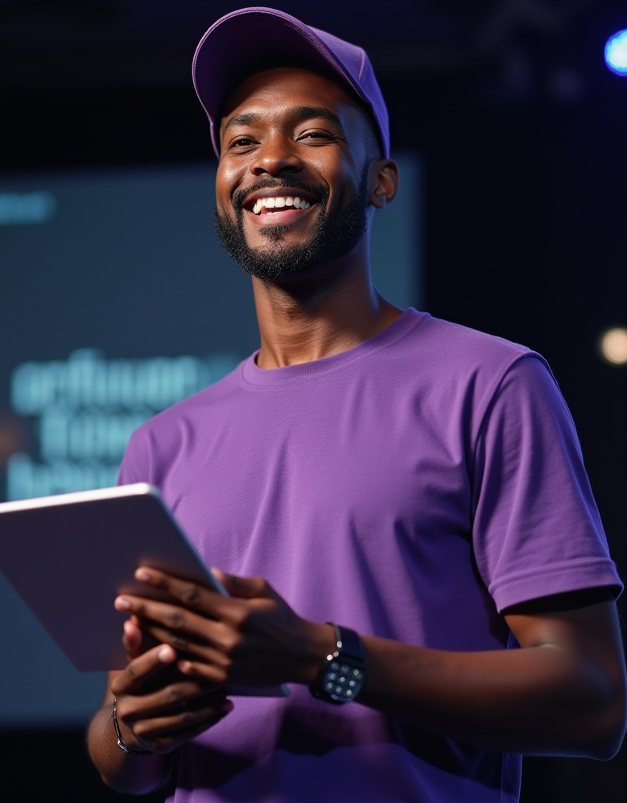

We close skills gaps and open career pathways,
preparing Africa’s workforce for the jobs of today
and tomorrow.
Redefining Talent. Powering Africa’s Growth

Slide 2

8.4
23%
230
Million
Million
ICT Roles Held by Women
Unemployed South Africans
OPPORTUNITIES
Huge gender disaprity

Slide 3

Who We Are
Building Africa’s future-ready workforce by shifting perceptions of talent
From youth entering the job market to professionals enhancing their skills to stay ahead, we build the technical capabilities, soft skills, and adaptability needed for long-term career success. With deep expertise in professional workforce development and work readiness, we are responsive to market needs and collaborate with funders and visionary partners who see talent as a driver of growth, innovation, and inclusive economic impact.
We empower individuals, advise industry and government, and drive systemic change to unlock value across the continent.
CAPACITI is part of the UVU Africa Group.

Slide 4
DRIVING QUESTION
How do we redefine talent to drive Africa forward?

Slide 5
Skills Development
Skills Innovation
Learnerships, internships, workplace experience, and digital eLearning aligned with NQF and QCTO to build skills and meet evolving workforce and compliance needs.
Curriculum design, assessments, hackathons, and reskilling initiatives that enable rapid capability building for impact in fast-changing work environments.
SERVICE AREAS
Our Areas of Expertise
Consultancy Services
Freelance Gig Support
Expert support in learning, compliance & detailed audits to meet B-BBEE goals, identify tax
& CSI incentives, strengthen workforce strategies & align with national policies & frameworks
Provide flexible outsourcing & hotdesking facilities. Support services tailored to freelancers & gig workers on global platforms like Fiverr, Upwork, and Freelancer.com
Highlighted Image 1200 x 717 px

Slide 6

Our Skills Offerings
Technology
Artificial Intelligence
Human Capital Development
Entrepreneurship
Product set developed through years of engagement with industry answering the core and critical technology skills gap in Africa
Answering the need for all sectors to have Al training with relevance for a competitive advantage
Developed through decade long experience at the intersect of individual potential growth and recognition
Equipping individuals & businesses with the relevant skills and entrepreneurial mindsets to develop sustainable ventures.
By providing accessible and transformative learning opportunities, CAPACITI is helping to bridge the digital divide
and unlock the potential of individuals and communities.

Slide 7

Our Holistic Development Model

Slide 8

Our Training Pathway Model
Step 1:
Bootcamp
Step 2:
Applied Learning
Step 3:
Work Experience
CAPACITI Delivered
Client Delivered
6 Months
Min. 6 Months
Step 1
Initial 2-month bootcamp, including fast track tech immersion and workplace readiness elements
Step 2
Advanced Technical Skills Training, Skills Application and Professional Development
Step 3
Workplace Experience including coaching, application and transitioning into the workplace

Slide 9
6000+
Salaries Earned
R460M
Individuals trained in digital skills & work readiness
Our Impact
40+
Job opportunities created
8000+
Programmes Run
Candidates taken into demand partnerships
50+
78%
Corporate Partners

Slide 10

Why Partner with Us
Partnering today to build Africa’s workforce for tomorrow.
End-to-End Talent Solutions – Recruitment, training, mentorship, and monitoring
Proven Impact – Measurable outcomes with detailed reporting
Strategic Alignment – Supports your CSI, ESG, HR, transformation, and BBBEE goals.
Nationwide Reach – Deep community engagement to connect with talent where it matters most

Slide 11
















Our Partners

Slide 12
















Our Partners

Slide 13
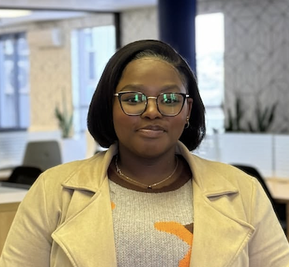
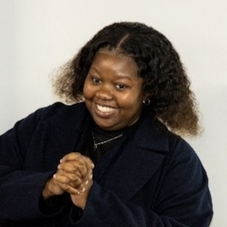
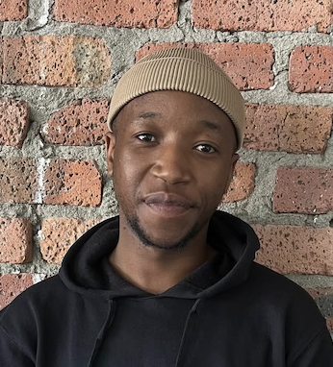
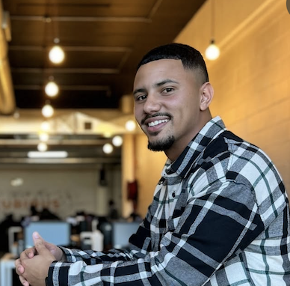
100M+
”Today , I’m thriving in a role I thought was out of my league”
FUNDING RAISED ANNUALLY
”I now have the confidence to pursue my long-term goal of moving to the product team”
4
SASEKANI MALULEKE
LOYISILE
HUBS ACROSS SA
67%
“Despite my tough start, today I’m an intern with a promising tech career ahead.”
“I love that everything is happening so fast and that I am constantly learning. !"
AVERAGE FEMALE PARTICIPATION
SIPHELO NYANDANA
MARQUEES ARENDSE

Slide 14
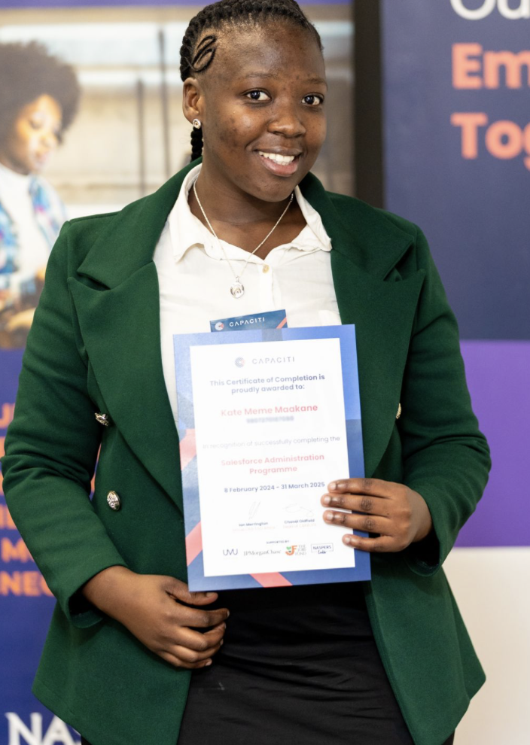

"I started this journey in flip-flops, unsure if I belonged. Today, I walk into boardrooms as a Junior Digital Administrator—proof that growth starts when someone believes in you, and you begin to believe it too. "
KATE MAAKANE, SALESFORCE ADMINISTRATOR

Slide 15

Thank You!

Slide 16

“By 2030, over 230 million jobs in sub-Saharan Africa will require new skills — creating an unprecedented demand for upskilling and reskilling.”
(Source: World Bank, 2022)

