Slide 1
The Startup Gold Rush:
Building on Digital Public Infrastructure (DPI)
Baratang Miya
Founder, Girlhype Coders Academy

Slide 2
The Illusion of the Invisible Internet
We see the app. We don't see the pipes.
* The internet is PHYSICAL. It runs on cables, towers, and data centers.
* But physical access is just the first step. The real question is:
What can you DO with it?
* For too long, the answer for millions has been: "Not much."
This is the Digital Divide.
Infrastructure without opportunity is just concrete and fiber optic.

Slide 3
The Problem: The Digital Chasm
❌ No Identity: Can't prove who you are to open a bank account, get a loan, or access government services.
❌ No Access to Payments: Stuck in a cash economy, excluded from e-commerce and modern gig work.
❌ Data Poverty: Your financial, health, and educational history is invisible, locked away in silos. You are "credit invisible."
❌High Friction, High Cost: Simple tasks are complex and expensive
This chasm isn't just a social problem. It's the world's largest untapped market.

Slide 4
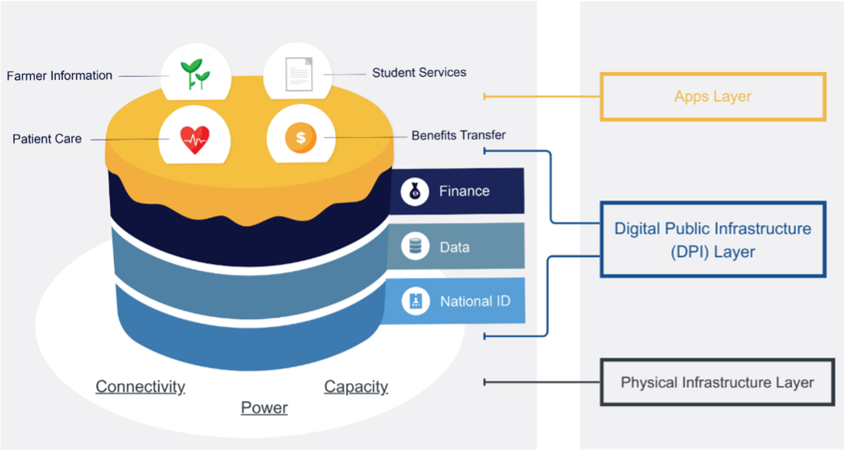
Digital Public Infrastructure (DPI)

Slide 5
The Magic of Interoperability:
The Real Game-Changer
Before DPI:
Walled gardens.
To serve a customer, you had to build everything yourself.
High cost, low scale.
After DPI:
Open ecosystems. You can plug into existing, trusted systems.
  Verify a customer's identity** in seconds.
  Send/receive payments** from anyone, to anyone, cheaply.
  Access financial data** (with user consent) to underwrite a loan.
This radically reduces the cost of innovation and scaling.

Slide 6
The Opportunity is $12 Trillion
This is the value of digitalisation waiting to be unlocked in emerging economies by 2030 (Source: Gates Foundation, World Bank, Tata Sons).
This value will be captured by businesses that solve real problems for the next billion users.
This isn't about creating new demand; it's about serving existing, pent-up demand with efficient digital solutions.
The market is there. The tools (DPI) are being built.
The question is: who will build the businesses?

Slide 7
The Startup Playbook: How to Build on DPI
DPI is the engine. Startups are the vehicle. Here’s what you can build:
🚀 Fintech & Lending:
Use Case: Instant, paperless microloans for small merchants using their digital ID and verifiable transaction history from their phone.
Example: Okra (Nigeria) uses open APIs to build personal finance apps.
🏥 Healthcare (Healthtech):
Use Case: Portable medical records that a patient owns and can share with any doctor, anywhere, via consent.
Example: Emediate (Rwanda) - e-prescription platform.

Slide 8
The Startup Playbook: How to Build on DPI
📚 Education (Edtech):
Use Case: Verifiable digital certificates that can't be faked, allowing graduates to share credentials instantly with employers globally.
Example: GirlHype (South Africa) - adaptive learning platforms.
🛒 E-commerce & Gig Work:
Use Case: A freelance platform that can verify a worker's identity and pay them instantly, cross-border, with low fees.
Example: SweepSouth (South Africa) built a trusted marketplace; imagine it with integrated DPI for payments and ID.

Slide 9
This is a Startup's Dream
✅ Massive, Proven Market: You are solving for billions, not millions.
✅ Reduced Compliance & Fraud Cost: KYC (Know Your Customer) is now a simple API call, not a massive operational headache.
✅ Faster & Cheaper Scaling: Plug into national infrastructure instead of building your own.
✅ Trust by Association: Building on government-sanctioned, secure rails builds instant trust with your users.
✅ Focus on Innovation, Not Infrastructure: Focus your precious capital and talent on your core product and user experience, not on building foundational tech.

Slide 10
The Call to Action: How to Get Started
1. Think "DPI-First":
Don't ask "What problem can I solve?"
Ask "What problem can I solve NOW that DPI exists that I couldn't solve before?"
2. Engage with the Ecosystem:
Follow: Digital Public Goods Alliance (DPGA), MOSIP, Mojaloop).
Use: Open-source DPI solutions to prototype fast and cheaply.
Advocate: For open, inclusive DPI policies in your country.
3. Build for the User: DPI is powerful but can be complex. Your job is to hide that complexity behind a beautiful, simple, user-centric interface.
Solve a real, painful problem. The scale will follow.

Slide 11
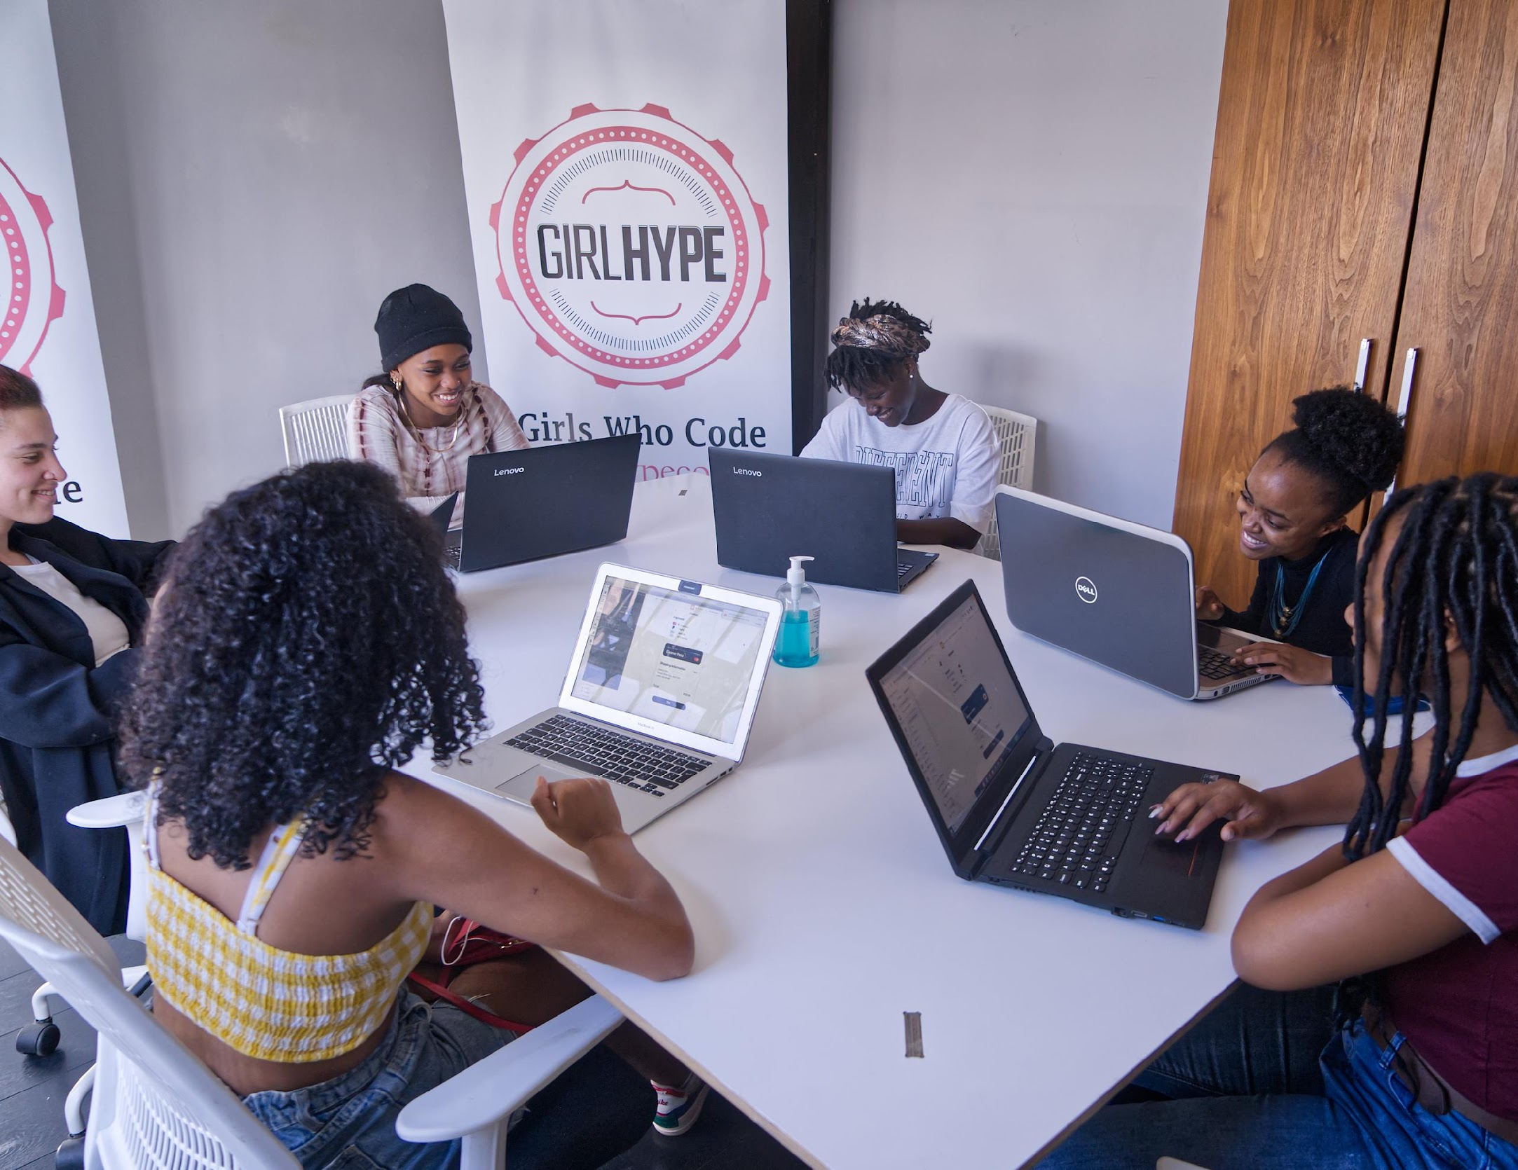
Now, it is our turn.
We are:
The entrepreneurs
The coders
The dreamers who will build the applications that bring this infrastructure to life.
The baseplate is down. Let's build.

Slide 12
Thank you!
Baratang Miya
CEO, Girlhype Coders Academy
Email: baratang@girlhype.co.za
Twitter: @BaratangM
Organization: @GirlHype

