Slide 1



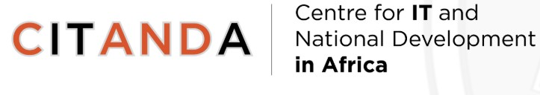
Strengthening Cybersecurity Capacity for Africa’s Digital Transformation
5th Annual Internet Summit
By
Dr Luzuko Tekeni
Faculty of Commerce, Department of Information Systems
University of Cape Town
28 August 2025

Slide 2
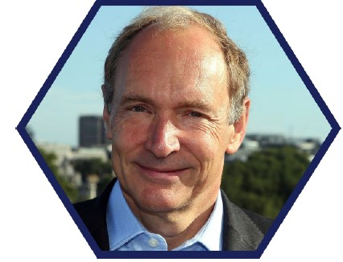
“
The goal of the Web is to serve humanity. We build it now so that those who come to it later will be able to create things that we cannot ourselves imagine.
”
Sir Tim Berners-Lee
Father of the World Wide Web

Slide 3
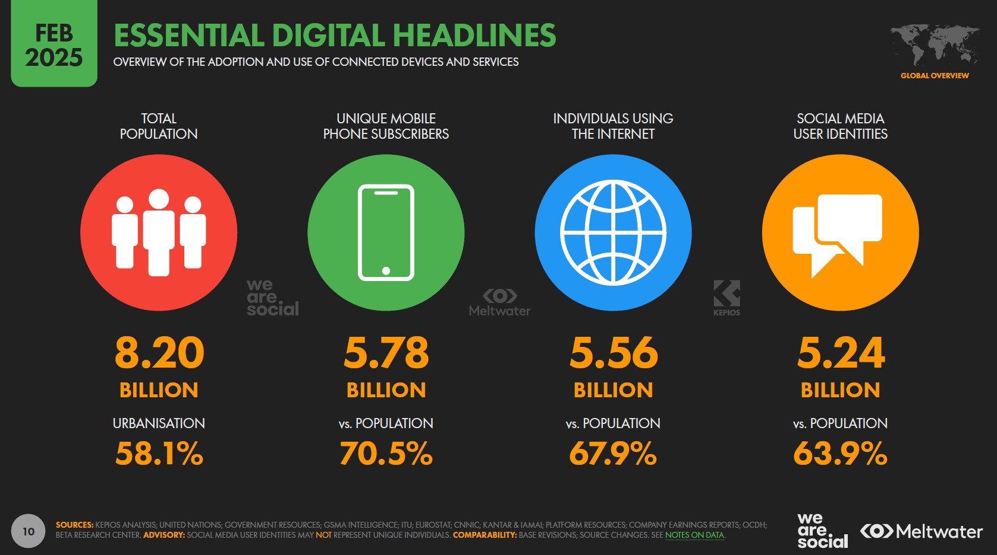

Slide 4
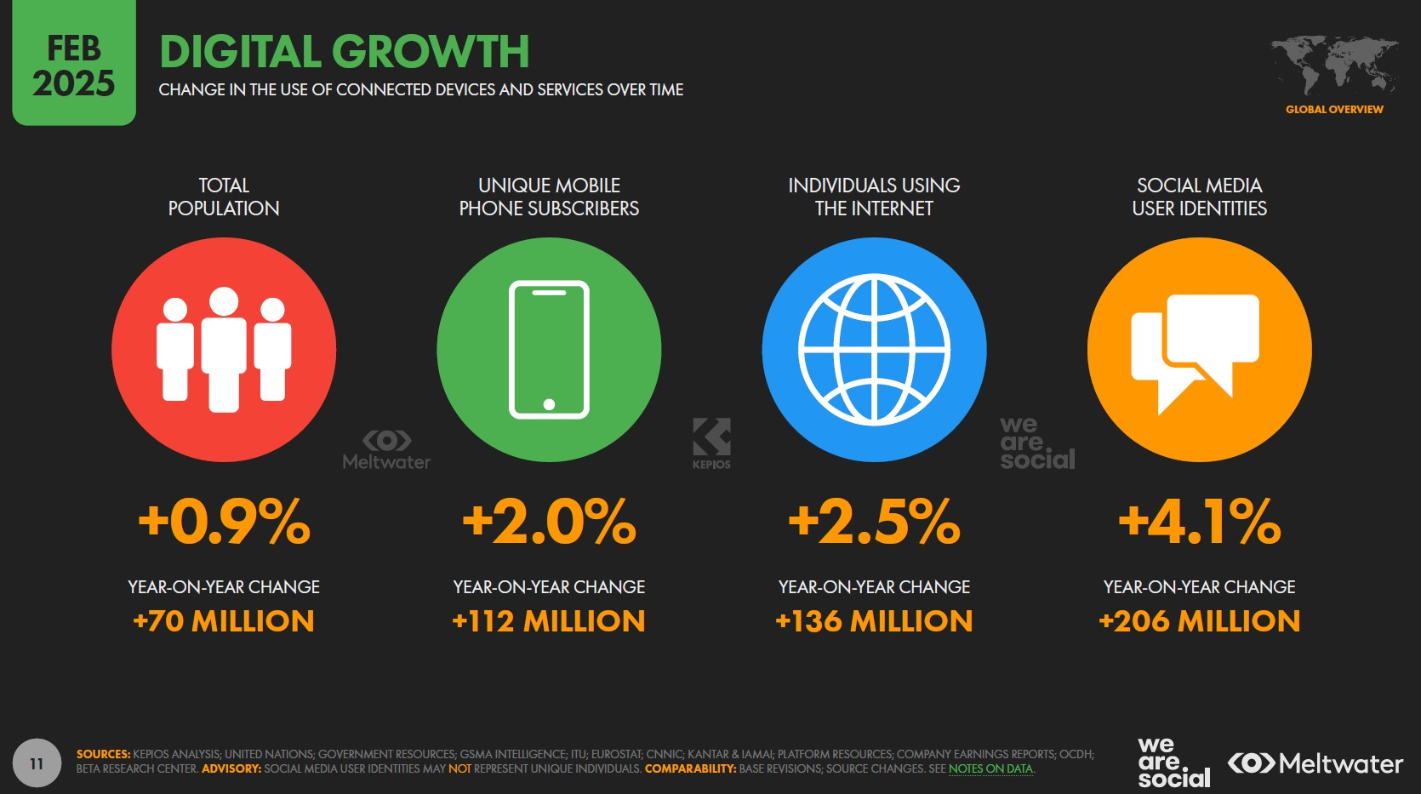

Slide 5
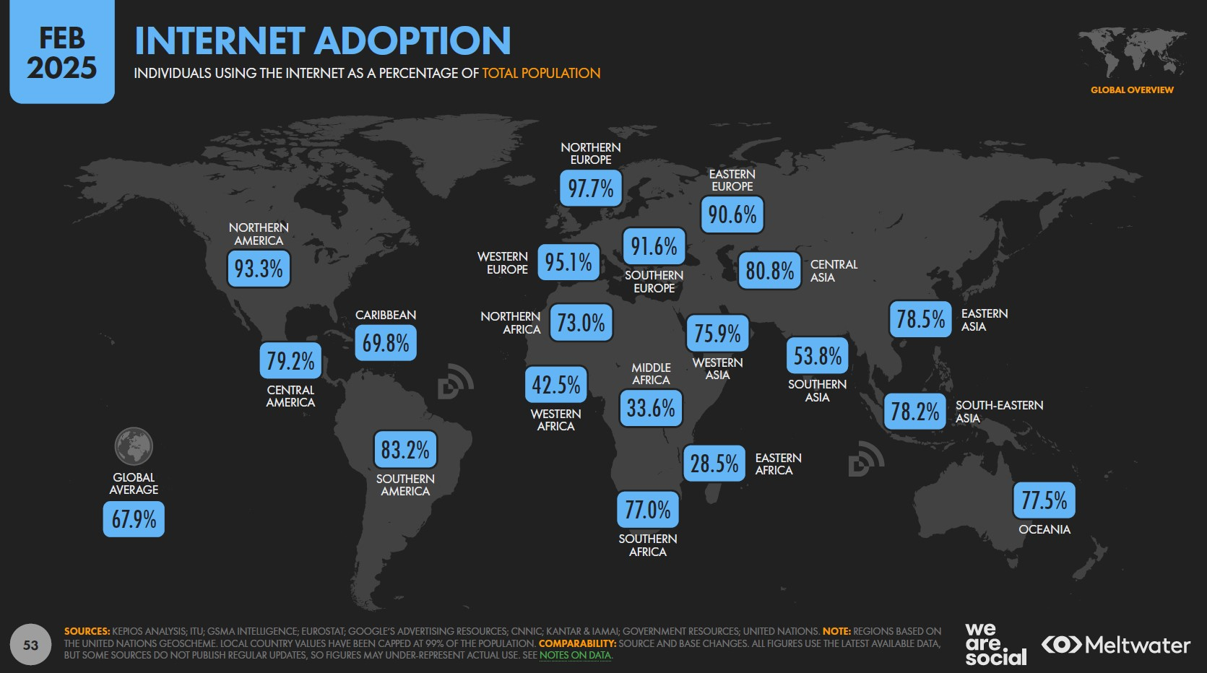

Slide 6
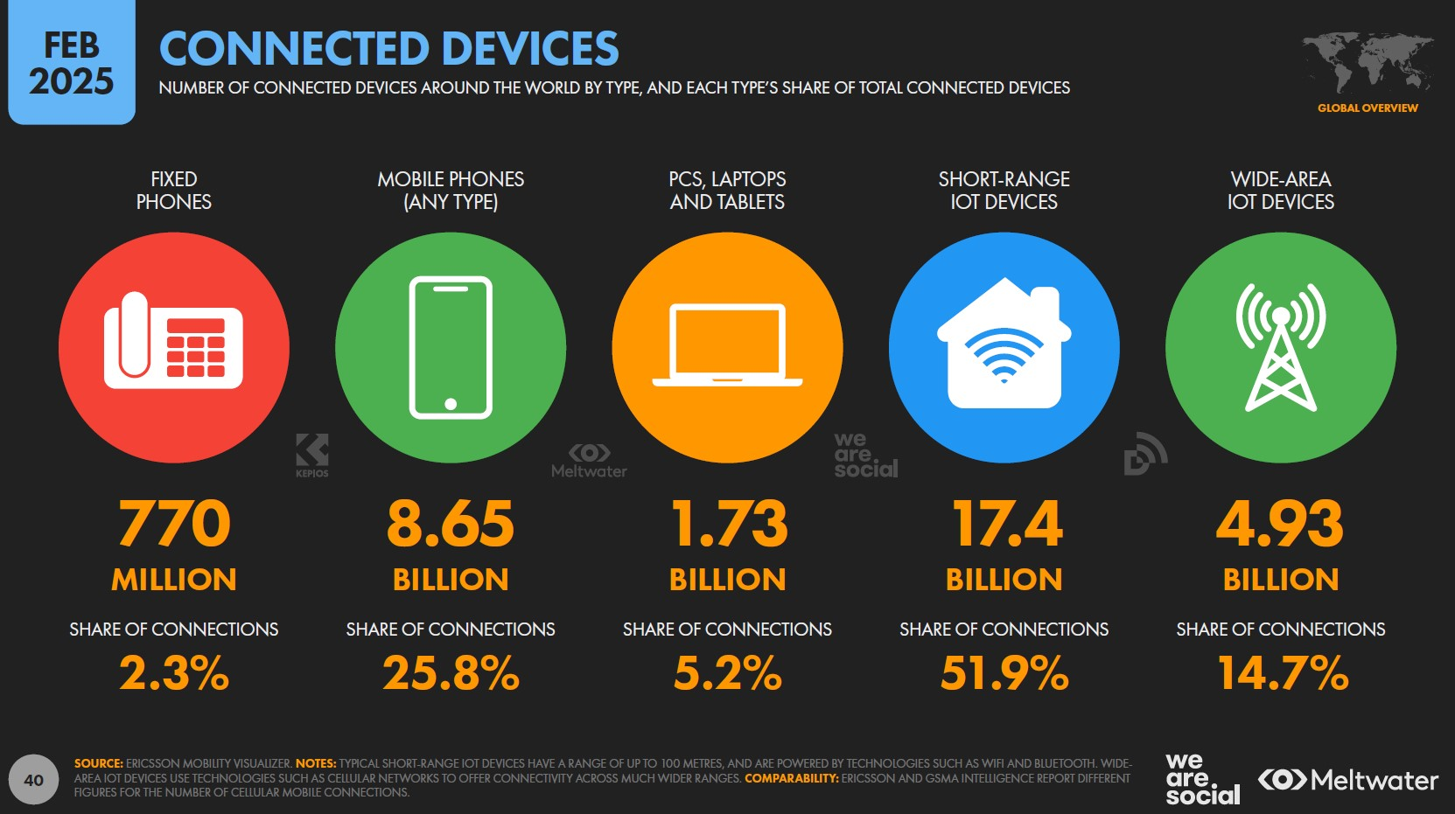

Slide 7
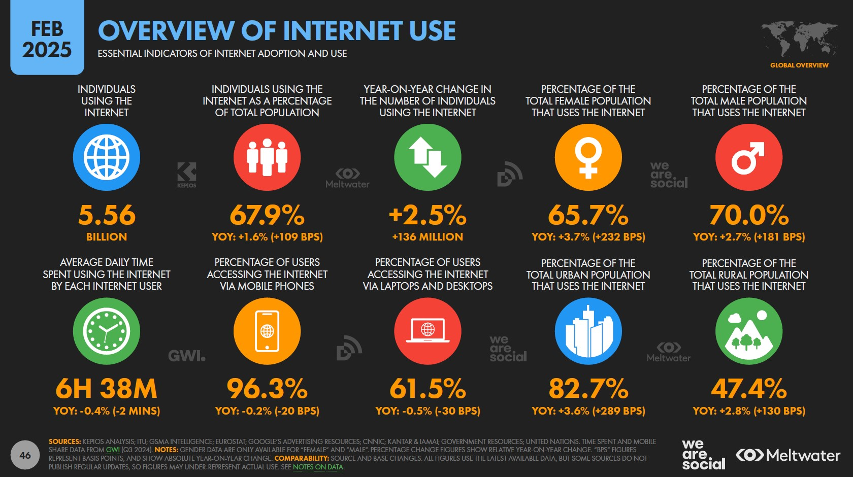

Slide 8
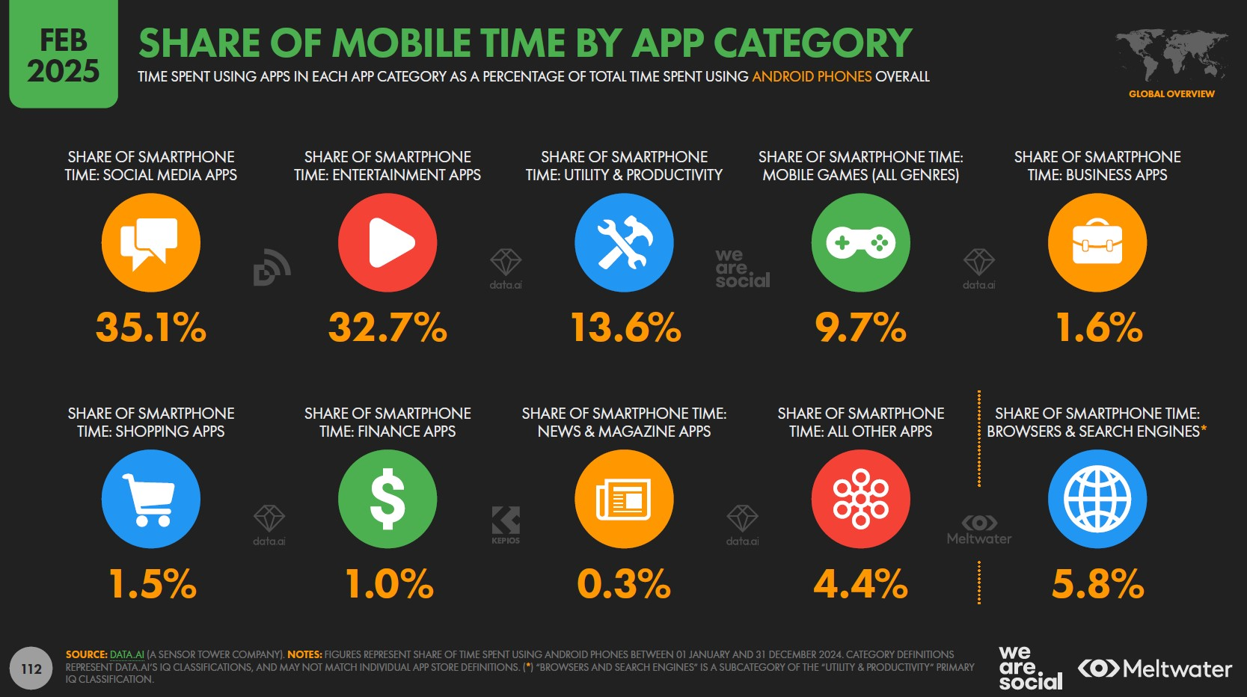

Slide 9
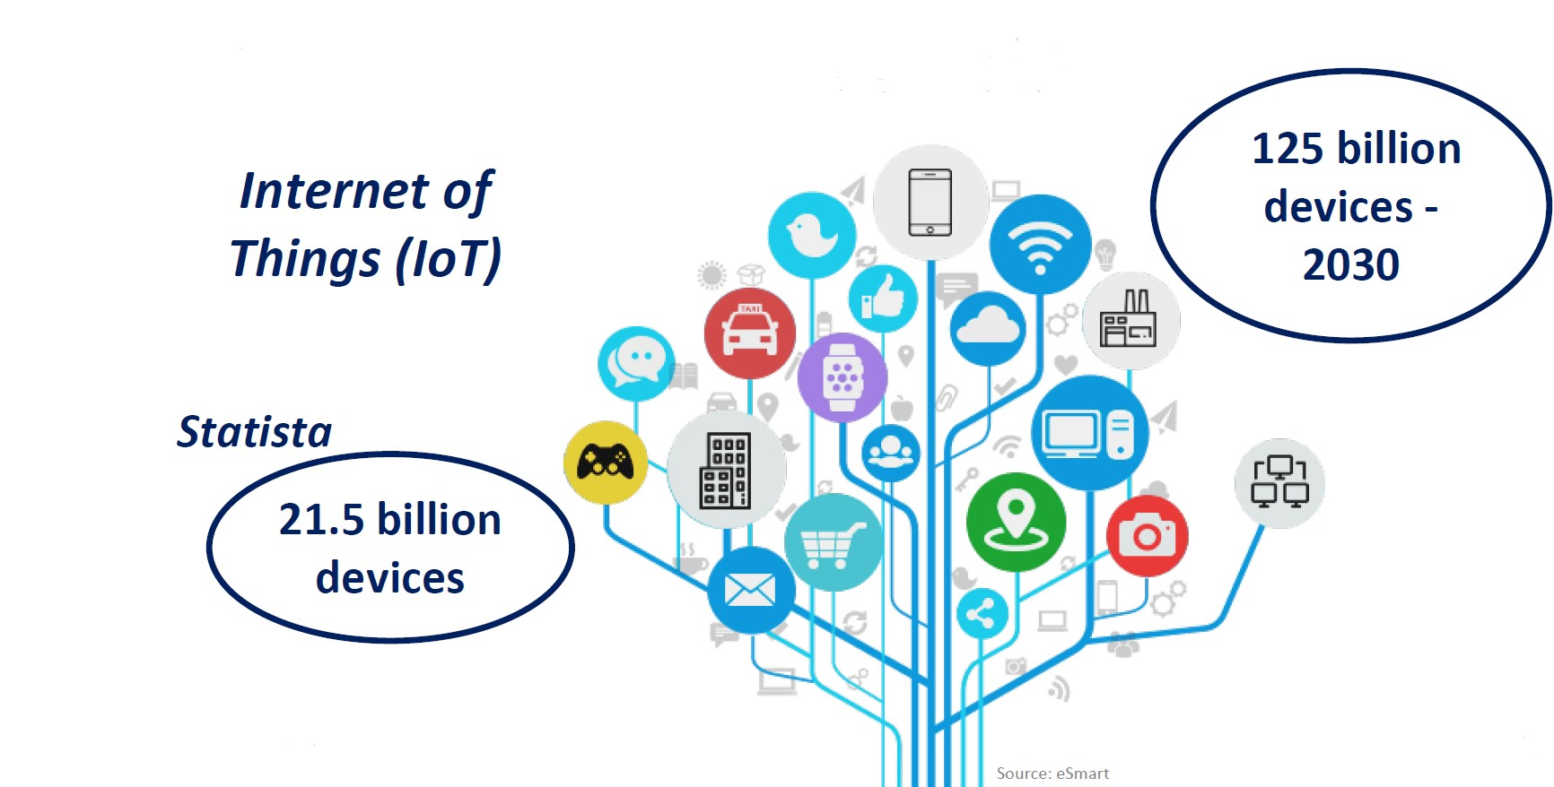
Our Interconnected World

Slide 10
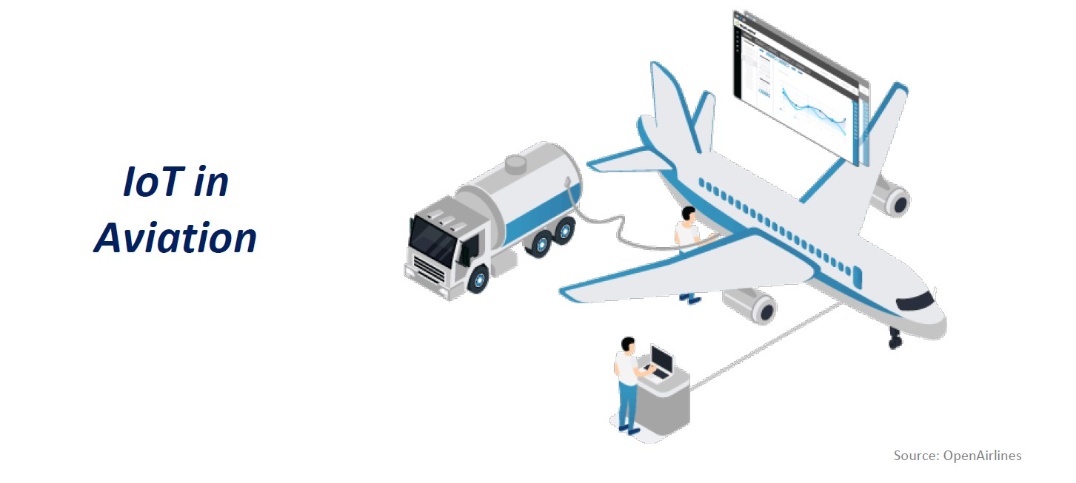
IoT Implementations

Slide 11

“
Advances in technology - hugely beneficial though they are - render us vulnerable in new ways.
”
Sir Martin Rees
UK Astronomer Royal

Slide 12
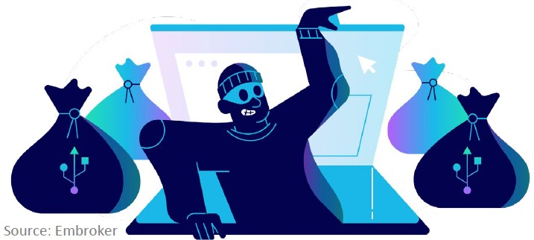
Cybercrime Pandemic
RiskBased Security
Over 37 Billion records compromised in 2020
648 threats per minute
Over 10 million DDoS attacks
New ransomware victim every 10 seconds
McAfee
Healthcare, Financial, Pharmaceuticals, Technology and Energy
IBM

Slide 13
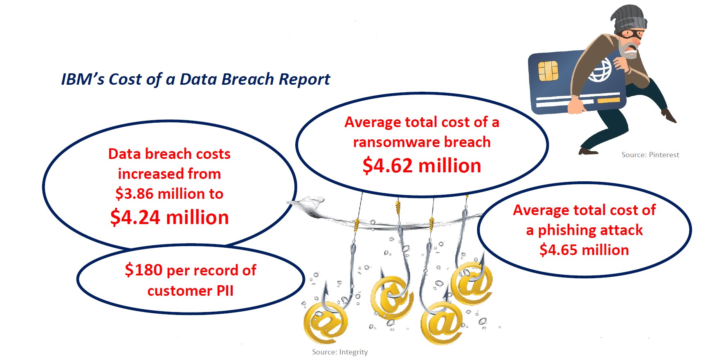
The Cost of Cybercrime

Slide 14




Overview of Cyberthreats across African sub-regions
CENTRAL AFRICA
NORTH AFRICA
WEST AFRICA
WEST AFRICA
Low digital literacy and weak infrastructure:
Cameroon saw cyber incidents nearly double in 2024.
Most cases go unresolved due to limited cybersecurity capacity in the sub-region.
Cyberattacks in 2024 surged, driven by geopolitical tension and digital expansion:
Egypt accounted 13% of all attacks in the sub-region.
Social engineering and phishing scams, often via WhatsApp and Fake investments are on the rise.
Rapid digital growth, especially in mobile money and social media has made West Africa a cybercrime hotspot:
Ghana recorded nearly 5000 DDoS attacks with telecoms heavily targeted.
Mobile wallet and romance scams are rising.
AI-enhanced phishing and deepfakes are growing threats.
EASTERN AFRICA
SOUTHERN
AFRICA
Digital expansion is outpacing cybersecurity readiness:
Ethiopia led the world in malware detections in 2024.
SIM swap fraud is on the rise in Uganda and Tanzania.
Sextortion and online harassment is increasingly common.
Home to Africa’s most developed cybersecurity, yet still under siege:
AI-driven deepfakes surged n 2024.
South Africa remains a top target, especially in finance and government.
Source: INTERPOL’s 2025 Africa Cyberthreat Assessment Report.

Slide 15
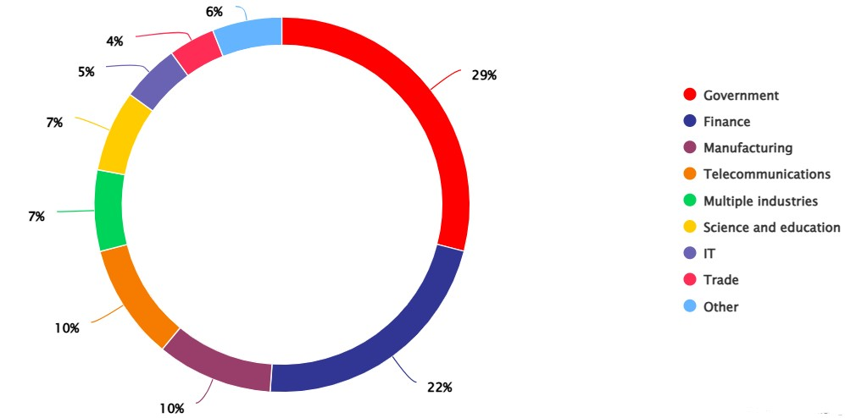
The Main Targets in the Region
Source: Positive Technologies

Slide 16
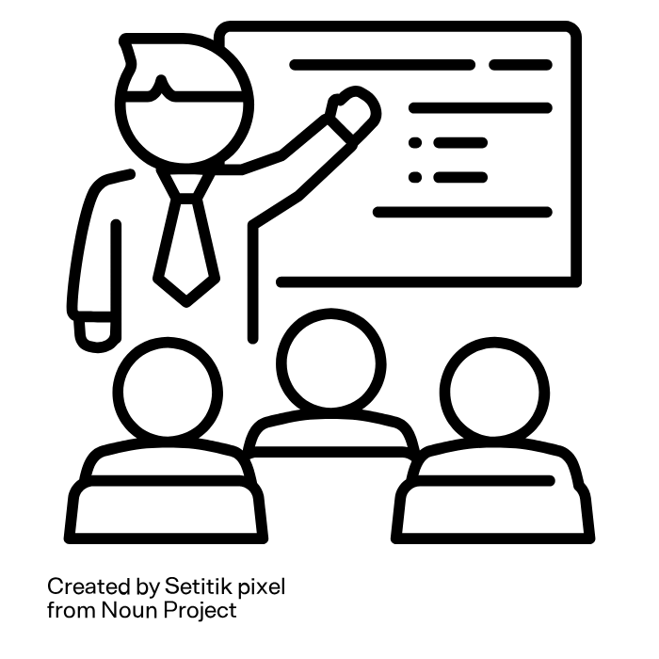
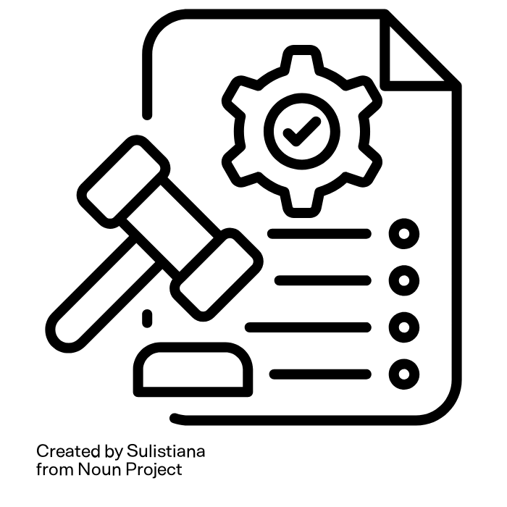
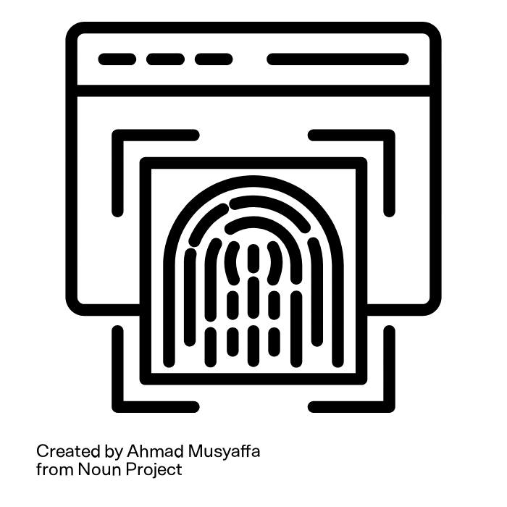
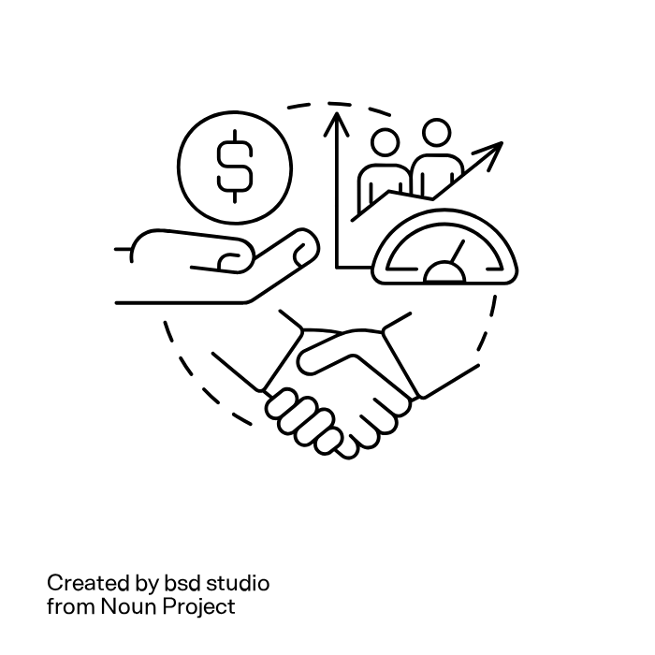




Key Areas for Cybersecurity Capacity
Skills Development and Training
Policy and Regulatory frameworks
Institutional and Technical Capacity Capacity
Multi-stakeholder Collaboration and Partnerships
01
02
03
04
Integrate cybersecurity in school curricula , encourage certification programs and academic research
Establish and enforce data protection laws. Harmonize Cybersecurity laws across borders. Encourage reporting of incidents without victim-blaming
Support the development of national CERTs and invest in cyber forensics and threat intelligence. Also Equip institutions with the tools to respond and recover.
Encourage public-private partnerships and foster regional cooperation for cybersecurity agenda.
Engage civil society and academia in solutions.

Slide 17
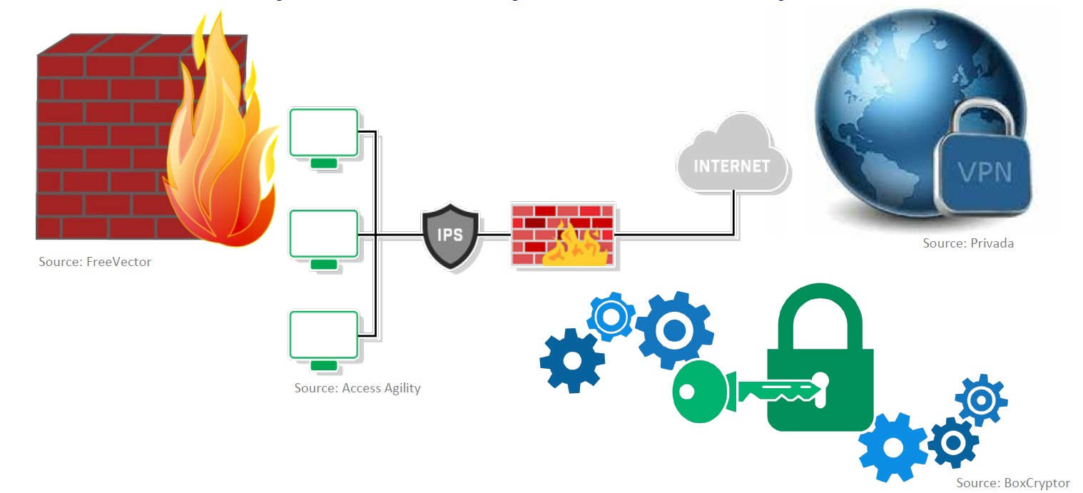
Human Aspects of Cybersecurity

Slide 18
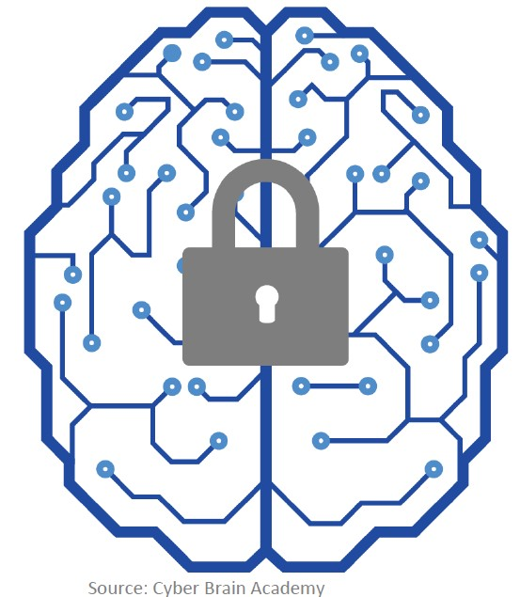
Human Aspects of Cybersecurity
Attitudes
Perceptions
Beliefs
behaviour

Slide 19
Recommendations
Prioritize cybersecurity funding and policies.
Foster a culture of continuous learning.
Build inclusive cybersecurity initiatives.
Leverage regional frameworks for cooperation.

Slide 20
“
The Web as I envisage it, we have not seen it yet. The future is still so much bigger than the past.
”
Sir Tim Berners-Lee
Father of the World Wide Web

Slide 21
Thank You!
Dr Luzuko Tekeni
Department of Information Systems
University of Cape Town
South Africa
Email: Luzuko.Tekeni@uct.ac.za

